Slide 1
MEDICAL INSURANCE COMPANY
A web application project Using Flask and MySQL database

Slide 2
Table of contents
Database Design
Backend
01
03
Web Frontend
Our web app
02
04
Our approaches to design the suitable database
How the database is linked to our web application
Our frontend design
Jurney through our website

Slide 3
1
Database Design
Our approach to designing the database

Slide 4
Designing the database
The steps we went through designing our database:
We first drew the ER diagram by hand on papers multiple of times until we got close to something concrete.
We then used an online tool to help us draw the final ER diagram containing most of the data we needed to implement the database.
And yet it wasn't the final design due to some implementation difficulties.
As soon as we reached our final design, we implemented the database using MySQL and it was ready to use.
Along the way designing the web app, we had to add some features to our final design but it was minimal changes.

Slide 5
Our assumptions
Individual (customer/dependent) can only have one contract and a single contract is linked to only one Individual.
Contract holds the plan type and the beneficiary of that plan.
Hospital can support one or more plan.
Many claims can be filed under the same contract, but the single claim can't be filed by more than one contract.
The dependent is weak entity and depends mainly on the customer
Claim must be filed regarding to only one hospital.
Customers can purchase a new plan and replace the old one with it for themselves and their dependents one at a time.

Slide 6
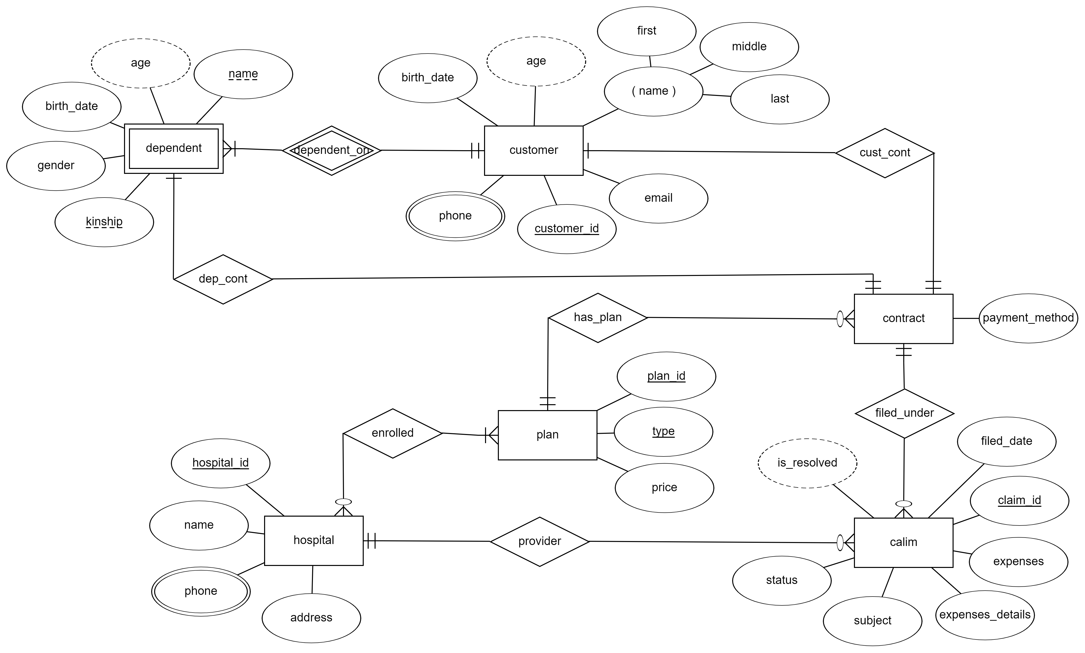
ER diagram

Slide 7
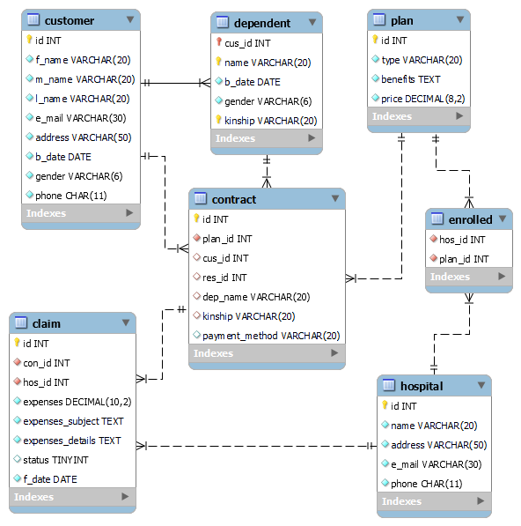
Database schema

Slide 8
Main Entities in our database
Customer
Dependent
Hospital
Contract
Claim
Plan
The customer of the company
Hospitals supported by the company
The dependent of a customer
Contract between the company and individuals
Claim filed by the customer
Plans provided by the company

Slide 9
Database Description

Slide 10
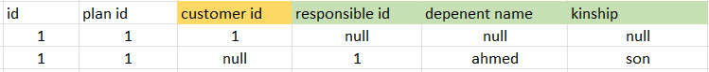
Contract Entity
It's the most complex entity in out design
It can only reference the dependent or the customer but not both at the same time. We managed to implement this using check constraints in MySQL.
We did it this way so that the individual (customer or dependent) can only have one contract and hence benefits from only one plan.

Slide 11
Claim Entity
Claim entity holds the id of the contract regarding the individual this claim is filed for.
From the contract id we can have all the data about the individual (customer/dependent)
The customer can file claims for his dependents using the dependent contract.

Slide 12
Create database
CREATE DATABASE medical_insurance;
USE medical_insurance;
CREATE TABLE customer (
id INT NOT NULL auto_increment PRIMARY KEY,
f_name VARCHAR(20) NOT NULL,
m_name VARCHAR(20) NOT NULL,
l_name VARCHAR(20) NOT NULL,
e_mail VARCHAR(30) NOT NULL,
address VARCHAR(50) NOT NULL,
b_date DATE NOT NULL,
gender VARCHAR(6) NOT NULL,
phone CHAR(11) NOT NULL );
CREATE TABLE dependent (
cus_id INT NOT NULL,
name VARCHAR(20) NOT NULL,
b_date DATE NOT NULL,
gender VARCHAR(6) NOT NULL,
kinship VARCHAR(20) NOT NULL,
FOREIGN KEY (cus_id) REFERENCES customer (id),
PRIMARY KEY (cus_id, name, kinship) );

Slide 13
Create database
CREATE TABLE hospital (
id INT NOT NULL auto_increment PRIMARY KEY,
name VARCHAR(20) NOT NULL,
address VARCHAR(50) NOT NULL,
e_mail VARCHAR(30) NOT NULL,
phone CHAR(11) NOT NULL );
CREATE TABLE plan(
id INT NOT NULL auto_increment PRIMARY KEY,
type VARCHAR(20) UNIQUE NOT NULL,
benefits TEXT NOT NULL,
price DECIMAL(8, 2) NOT NULL );
CREATE TABLE enrolled (
hos_id INT NOT NULL,
plan_id INT NOT NULL,
FOREIGN KEY (hos_id) REFERENCES hospital (id), FOREIGN KEY (plan_id) REFERENCES plan (id),
UNIQUE no_dup (hos_id, plan_id) );
The relationship between hospitals and the plans covered by each hospital.

Slide 14
Create database
CREATE TABLE contract (
id INT NOT NULL auto_increment PRIMARY KEY,
plan_id INT NOT NULL, o
cus_id INT DEFAULT NULL UNIQUE,
res_id INT DEFAULT NULL,
dep_name VARCHAR(20) DEFAULT NULL,
kinship VARCHAR(20) DEFAULT NULL,
payment_method VARCHAR(20),
FOREIGN KEY (cus_id) REFERENCES customer (id), FOREIGN KEY (res_id, dep_name,
kinship) REFERENCES dependent (cus_id,
name, kinship),
FOREIGN KEY (plan_id) REFERENCES plan (id),
UNIQUE res_id (res_id, dep_name, kinship),
CHECK ((cus_id IS NOT NULL) OR ( res_id IS NOT NULL AND dep_name IS NOT NULL AND kinship IS NOT NULL )),
CHECK ((cus_id IS NULL AND res_id IS NOT NULL) OR (cus_id IS NOT NULL AND res_id IS NULL)) );
The contract between the customer or any of his/her dependents and the medi][]cal insurance company.
when the customer purchases a contract, he will choose who is the beneficiary of this contract him or one of his dependents.

Slide 15
Create database
CREATE TABLE claim (
id INT NOT NULL auto_increment PRIMARY KEY, con_id INT NOT NULL,
hos_id INT NOT NULL,
expenses DECIMAL(10, 2) NOT NULL, expenses_subject TEXT NOT NULL,
expenses_details TEXT NOT NULL,
status TINYINT DEFAULT NULL,
f_date DATE NOT NULL,
FOREIGN KEY (con_id) REFERENCES contract (id), FOREIGN KEY (hos_id) REFERENCES hospital (id) );
Claim entity describes the claim insurance filed by the customer and can be reviewed by the admin to get accepted or rejected.

Slide 16
2
Frontend

Slide 17
Frontend
We have designed the frontend of the web application using HTML, CSS, and Bootstrap5.
We first designed the base template of the web application which contains the stamp that exists in every webpage of the web app I.e. (header, footer, title, scripts, and CSS includes )
Then we designed only the body of each page with placeholders to show our data in it.
We also used jinja2 to manipulate these html pages using the data passed from the backend.

Slide 18
Frontend
We used HTML input validations to ensure the data entered by normal users are correct and ready to be input in the database.
Basic customer login with no authentication is implemented and logs in as the first customer in the database.
Admin dashboard is available and contains the options that are available to the admin
Customers can file claims, add dependents, purchase plans, view available hospitals for themselves and each of their dependents, view their claims.

Slide 19
Frontend
We used JavaScript function to make our website responsive and limit what the user can do according to his plan.

Slide 20
3
Backend

Slide 21
Backend Topics
Web backend
Database handling
Providing data to render the HTML pages and handle the data we get from the users and modify the database according to it if possible
Handles getting, adding and modifying data in the database

Slide 22
Backend
In the Backend we:
Used library 'mysql-connector-python' to run pure MySQL queries
Create the database if it doesn't exist (with some demo data)
Get data from the database.
Add records to the database.
Alter data inside the database.

Slide 23
Backend
In the Backend we:
Received data from users sent by 'POST' and 'GET' requests and checked if all the data are correct in format and then use it to generate new pages of manipulating the database.
And if the data is incorrect we show a flash message to the user containing instructions about what might be wrong.

Slide 24
4
Final Results

Slide 25
We hosted the web application online and can be accessed at:
https://medical--insurance.herokuapp.com/
A GitHub repo of this project with some docs can be found at:
https://github.com/m-agour/Medical_Insurance

Slide 26
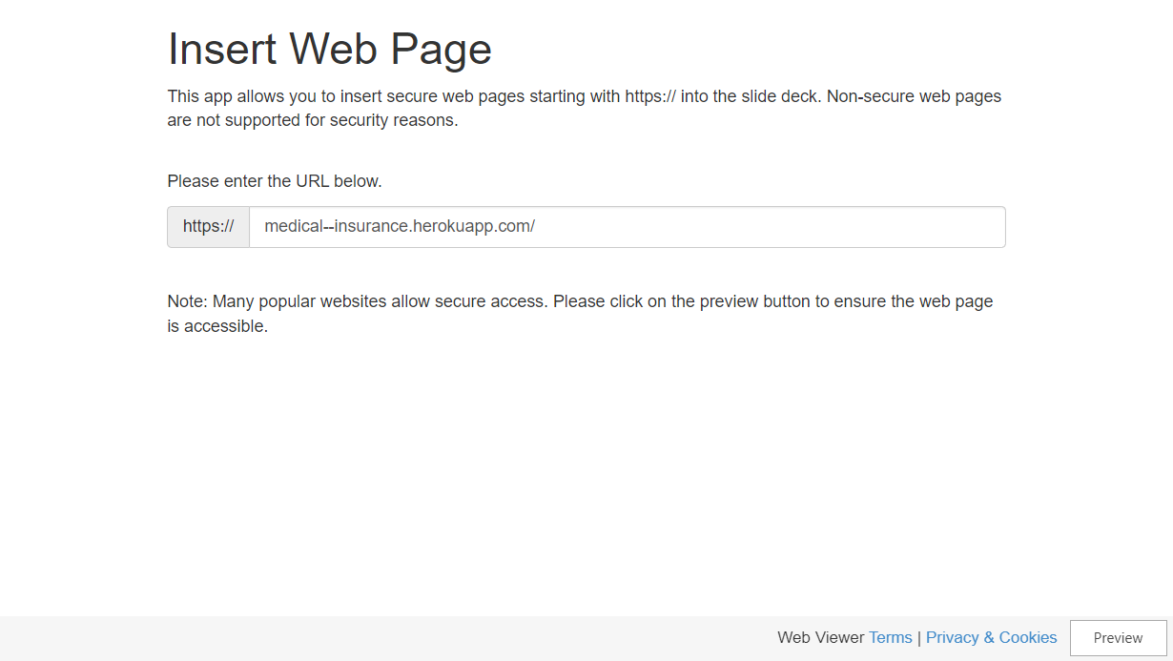

Slide 27
TEAM
Mariam Khalid Ragheb Yassien Noureldin
Mohamed Nagy Ibrahim Abouagour
Mohamed Abdelfatah Abdelfatah Elfeky
Menna Allah Moataz Medhat Zaki Mansour
Nada Yasser Mahmoud Mohammed Ali
Zaynab Sabry Abo Elmakarem Ali
Yara Nasser El-den Mohammed

Slide 28
Thank You!

